Slide 1

AI-Powered Telegram Bot
An introduction to a versatile & cloud-based chatbot
ZHAO Yanming GAO Yikai
2026.04.14
Notes:
Good morning/afternoon, everyone. My name is [Your Name], and today I am excited to present our project: the AI-Powered Telegram Bot. This is an introduction to a versatile, cloud-based chatbot designed to assist university students in various scenarios. Let’s dive into how we built this solution

Slide 2
CONTENTS
Project Overview
1
Technical Implementation
2
Deployment & Architecture
3
Demonstration
4
4
Notes:
Here is the roadmap for our presentation. We will start with the Project Overview, discussing the core functionalities and the problem we are solving. Next, we will take a deep dive into the Technical Implementation, covering the AI integration and the bot framework. We will then discuss the Deployment & Architecture on AWS, highlighting scalability. Finally, we will conclude with a live Demonstration of the bot in action."

Slide 3
Project Overview
A brief introduction to our chatbot project, covering its core functionalities, underlying technology stack, and key features.
3
Notes:
First, let’s look at the Project Overview. Our goal was to create a chatbot that acts as a conversational assistant for university students. The core purpose is to provide a versatile tool that can handle diverse needs through a modular design. This modularity ensures that while we have specific features now, we can easily integrate third-party services in the future, making the bot a long-term companion for students."

Slide 4
Project Introduction
What is this chatbot about?
01
02
03
Core Purpose
User-Centric Design
Modular Architecture
This project aims to develop a versatile Telegram chatbot that can assist users in various scenarios, leveraging the power of AI.
Designed specifically for university students, the bot provides a conversational and helpful experience, addressing their diverse needs.
The bot is built with a modular design, allowing for easy addition of new features and integration with third-party services in the future.
4
Notes:
"This brings us to the Core Features. The bot is designed to be a one-stop shop for student life.
Learning Assistance: It acts as a tutor, helping students understand complex topics.
Event Recommendations: It suggests activities based on user preferences.
General AI Helper: It serves as a default helper for university students, providing a conversational experience. The design is entirely user-centric, ensuring the bot is easy to interact with and understand."

Slide 5
Core Features
What can this chatbot do?
01
02
03
Learning Assistance
Event Recommendations
General AI Helper
4

Slide 6
Technical Implementation
A deep dive into the technologies and tools that power the chatbot, including its AI model, Telegram integration, and database solution.
3
Notes:
We now move to the Technical Implementation. This slide covers the backbone of our system. We will explore how the AI brain works, how we communicate with users via Telegram, and how we manage data through logging and our database. This is where the magic happens."

Slide 7
AI & ChatGPT Integration
How does the AI brain work?
1
ChatGPT API Utilization
2
Custom System Prompts
The bot harnesses the power of ChatGPT API to generate intelligent and context-aware responses.
Different prompts are defined to guide the AI's behavior and personality for each specific mode (QA, event, default).
3
Flexible Configuration
4
Chat Robot Implementation
API credentials and model details are managed through a configuration file, allowing for easy updates and deployment.
Use the interface and address provided by Telegram to accept the input of the Chat Robot and output the statement.
4
Notes:
Let’s start with the AI & ChatGPT Integration. The bot harnesses the ChatGPT API as its brain to generate intelligent, context-aware responses. To ensure the bot behaves appropriately, we utilize Custom System Prompts. These prompts guide the AI's personality and behavior for each specific mode—whether it is in QA mode, Event mode, or the default mode. Finally, we maintain Flexible Configuration by managing API credentials and model details through a configuration file. This allows us to update the model easily without rewriting the core code."

Slide 8
Telegram Bot Framework
How does it communicate with users?
1
Telegram Bot API
2
Asynchronous Handling
Utilizes the python-telegram-bot library to build a robust and scalable Telegram bot.
Employs async/await syntax for efficient and responsive handling of user messages and API calls.
3
Message Filtering
4
Command-Based Interaction
Filters user inputs to differentiate between commands and regular text messages for appropriate processing.
Implements slash commands (\QA, \event, \default) to allow users to switch between the bot's functionalities seamlessly.
4
Notes:
"To communicate with users, we use the Telegram Bot Framework. We utilize the python-telegram-bot library to build a robust application. A key technical choice was employing Async/Await syntax. This allows the bot to handle user messages and API calls efficiently and responsively, ensuring users don’t experience lag. Interaction is streamlined through Slash Commands. Users can type \QA, \event, or \default to seamlessly switch between the bot’s different functionalities

Slide 9
Logging & Database
How is data managed and analyzed?
1
MongoDB for Logging
3
Environmental Configuration
All user interactions and bot responses are logged into a MongoDB database for comprehensive analysis.
Database connection details are securely managed using environment variables, enhancing portability and security.
2
Cloud-Based Deployment
4
Custom Logging Handler
Both the chatbot and the MongoDB database are deployed in containers on AWS Cloud, ensuring high availability and scalability.
A custom logging handler is implemented to automatically send log records to the MongoDB collection in real-time.
4
Notes:
"Data management is critical for analysis and debugging. We use MongoDB to log all user interactions and bot responses. This provides a comprehensive record for future analysis. We also implemented a Custom Logging Handler that automatically sends log records to the MongoDB collection in real-time. Security is maintained by storing database connection details as Environment Variables, enhancing both portability and security."

Slide 10
Deployment & Architecture
An overview of the chatbot's hosting environment, its scalable architecture, and the benefits of using cloud services for deployment.
3
Notes:
Next, we look at Deployment & Architecture. We chose a cloud-based approach to ensure high availability and scalability as the user base grows

Slide 11
Cloud Hosting on AWS
Why choose AWS for deployment?
1
2
3
4
Infrastructure as a Service (IaaS)
Containerization with ECS
Auto Scaling
Global Reach
AWS Cloud provides a robust and scalable infrastructure, allowing the bot to handle a growing number of users.
The chatbot and database are deployed as Docker containers on AWS Elastic Container Service (ECS) for portability and efficiency.
ECS can automatically scale the number of container instances based on traffic, ensuring optimal performance during peak usage.
Leverages AWS's global network for low-latency access from users around the world.
4
Notes:
"Why AWS? We utilize Infrastructure as a Service (IaaS) to handle a growing number of users. The application is Containerized with ECS (Elastic Container Service), which packages the bot and database for portability. Crucially, we leverage Auto Scaling. ECS automatically adjusts the number of container instances based on traffic, ensuring optimal performance during peak usage times. Finally, AWS's global network ensures low-latency access for users around the world.

Slide 12
System Architecture
How are the components connected?
1
2
3
4
5
Frontend: Telegram Bot
Backend: Python API Client
Brain: ChatGPT AI Model
Memory: MongoDB Database
Orchestrator: AWS ECS
Acts as the user interface, receiving messages and sending responses via the Telegram platform.
Processes user inputs, communicates with the ChatGPT API, and retrieves responses.
The core intelligence that generates context-aware and relevant responses based on user queries.
Stores all chat logs for analysis, debugging, and performance monitoring.
Manages the lifecycle of the chatbot and database containers, ensuring high availability and scalability.
4
Notes:
"This brings us to the System Architecture diagram. Visually, the Frontend is the Telegram interface where users send messages. The Backend, written in Python, processes inputs and talks to the Brain, which is the ChatGPT AI Model. All interactions are stored in the Memory, our MongoDB Database. Finally, the Orchestrator, AWS ECS, manages the entire lifecycle of these containers to ensure everything runs smoothly."

Slide 13
Demonstration
Visual examples of the chatbot in action, showcasing its user interface and the insights gained from the logging database.
3
Notes:
Finally, let’s see the bot in action. We have two examples here: the user interface interaction and the backend log analytics."

Slide 14
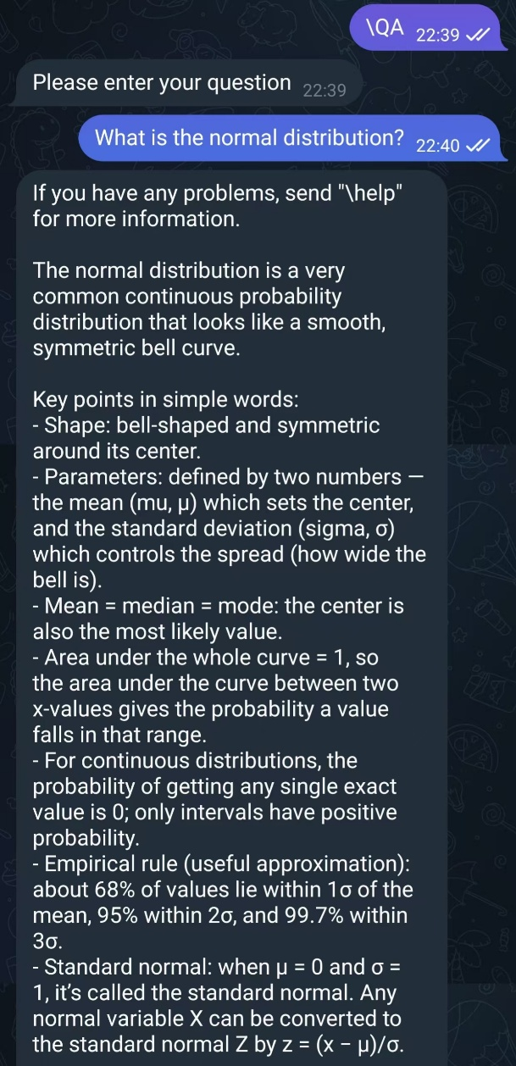
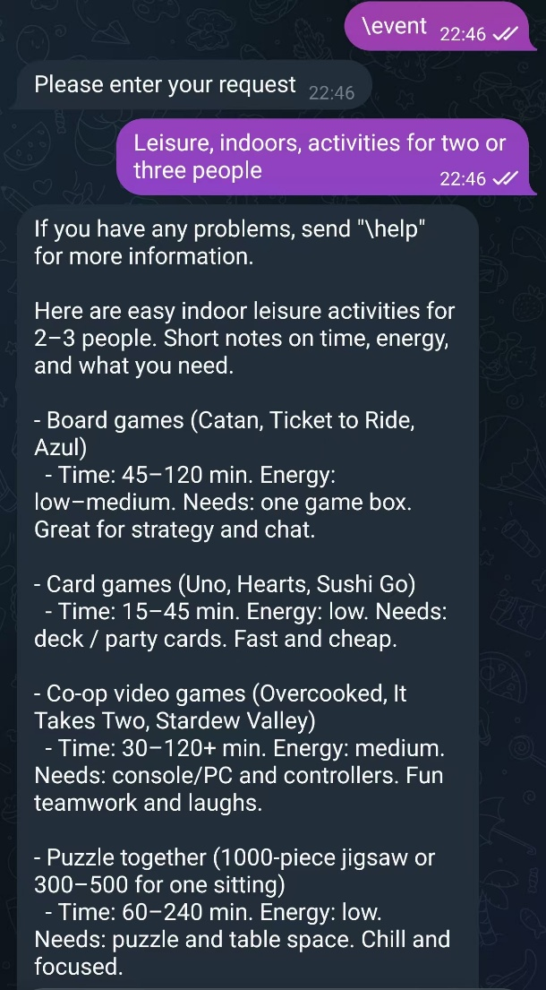
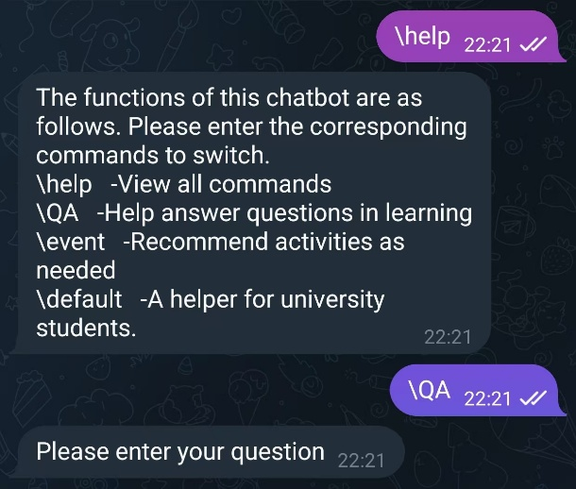
User Interaction Example
4
Notes:
"This slide shows the User Interaction. First, the user types \help to see available commands. They then switch to QA mode by typing \QA and ask, 'What is the normal distribution?' The bot responds with a detailed, accurate explanation of the statistical concept, demonstrating its learning assistance capability. In another example, the user switches to Event mode by typing \event and requests indoor leisure activities for 2-3 people. The bot generates a list of suggestions, including board games and co-op video games, complete with time estimates and energy levels. This shows the bot’s versatility in providing context-aware recommendations."

Slide 15
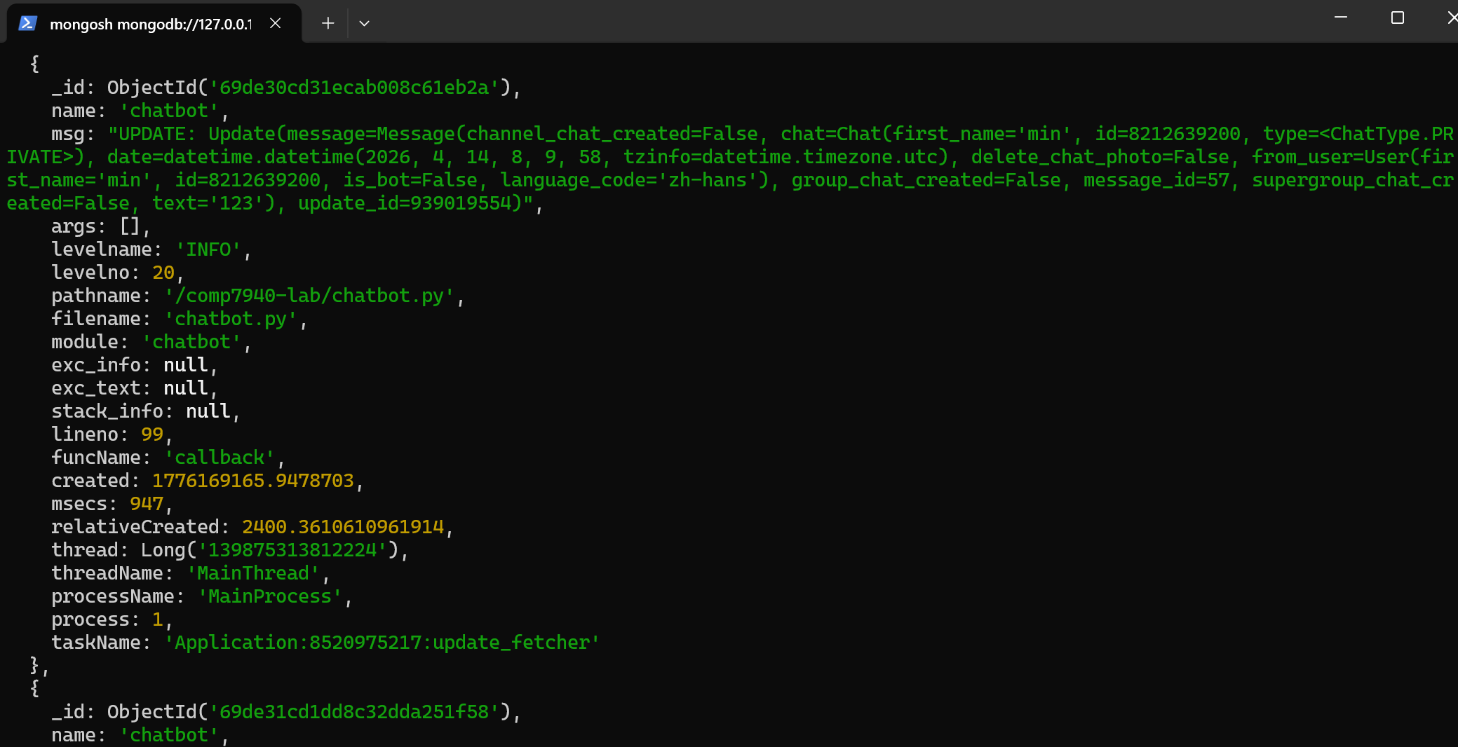
Log Analytics Example
4
Notes:
Finally, we look at the Log Analytics. This screenshot shows the MongoDB shell. You can see the raw JSON logs capturing every update. For instance, it records the message ID, the user ID (8212639200), the timestamp (April 14, 2026), and the exact text sent by the user. This real-time logging is crucial for us to monitor performance, debug issues, and analyze how students are actually using the bot to improve its future iterations."

Slide 16
Thanks for watching
ZHAO Yanming GAO Yikai
2026.04.14
Notes:
"In conclusion, we have built a versatile, scalable Telegram bot that leverages AI to assist students. Thank you for your attention. I am happy to take any questions you may have."

